Slide 1
Group Recommendations
DATA.ML.360-2023-2024-1 - Recommender Systems
Sachini Indiketiya Hewage - 152258085
Robin Ivan Villa Soto - 151814365

Slide 2
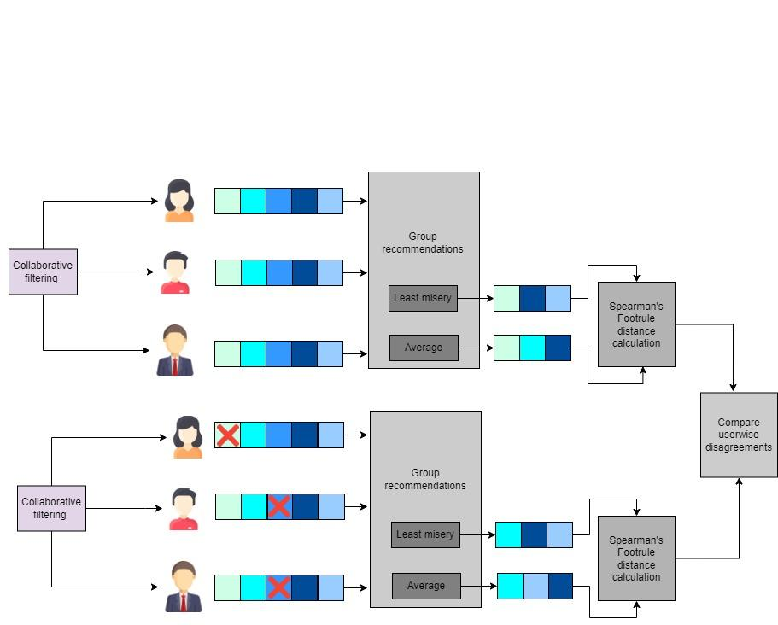
Introduction

Slide 3
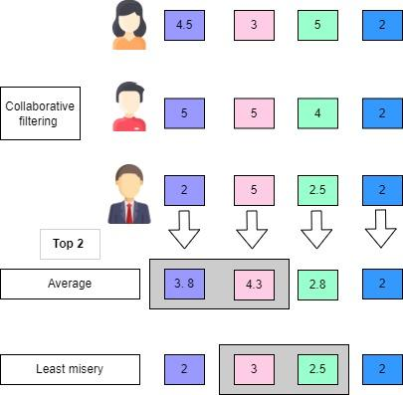
Group recommendations methodology
We selected 3 random users and extracted all their available unwatched movie ratings using top 20 similar users in collaborative filtering.
Then we both mean and least misery methods for each movie as aggregation methods to figure out the top 10 movies we can recommend for these 3 users.

Slide 4
Disagreement counting method and suggested improvement
Since this does not take disagreements between users into account, we calculated Spearman’s Footrule Distance which considers the difference between ranking in the sorted group recommendations and the sorted personal recommendations list for each user as a disagreement measurement.
Then for each user, we dropped the movies from the dataset where the predicted are less than the average rating for the user.Next, we used this new dataset as an input to the mean and least misery methods so that no item in group recommendations would displease any user below their average.
When comparing improvement with the generic implementation, we considered the per-user disagreements to get an overview of whether it has provided an overall better suggestion for each user.

Slide 5
Potential future improvements
We can improve the collaborative filtering method using better similarity measures / algorithms so that the initial input to the group recommendations itself is of higher reliability.
We can consider a larger number of similar users in collaborative filter rating prediction.

